Slide 1
DocFlow
AI-powered document processing platform.

Slide 2
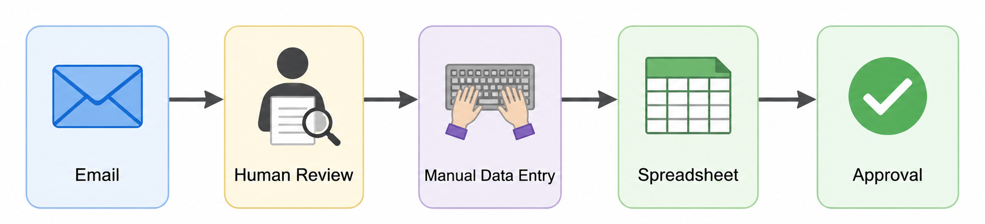
Many documents!
Many types of documents!
Candidate CVs
Invoices
Contracts
Problems!
slow
expensive
inconsistent
impossible to scale efficiently

Slide 3
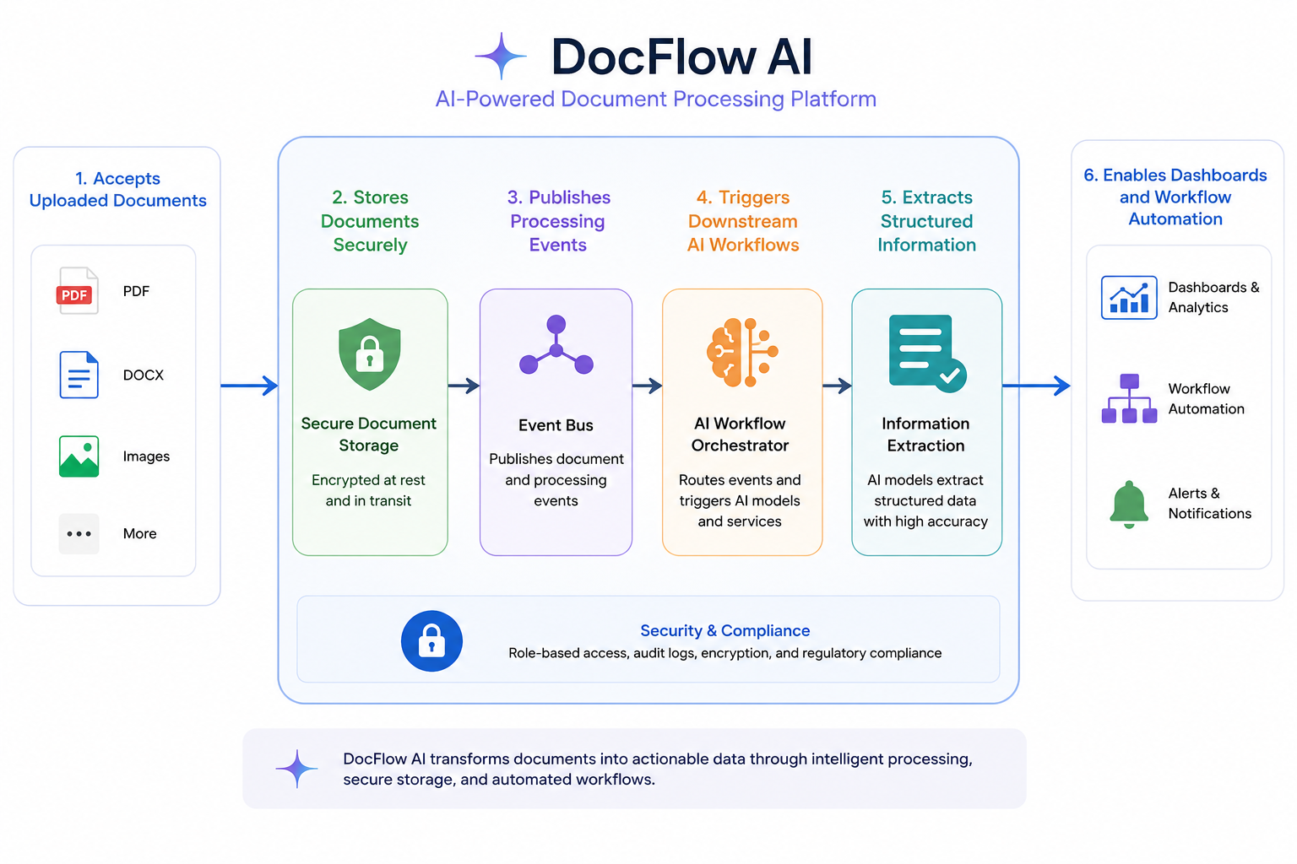

Slide 4
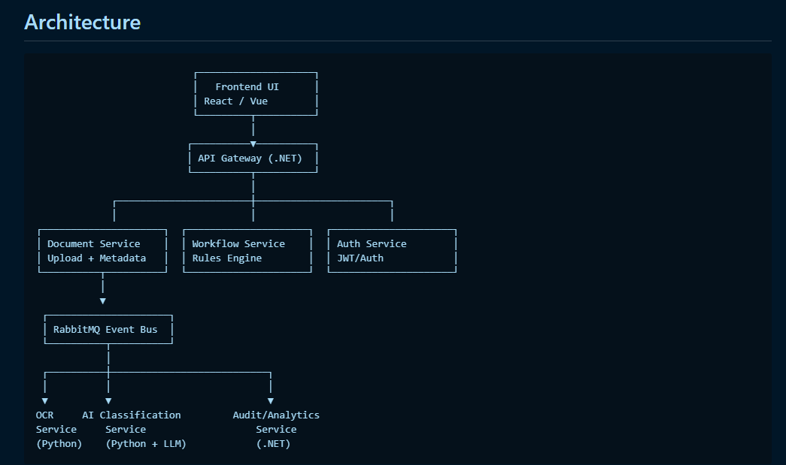
Upload File
Blob Storage
AI Services

Slide 5
Coming soon - UI
Swagger
Document Service Api
Upload file
doc-uploaded
Blob Storage
doc-processed
AI Service

Slide 6
Demo

Slide 7
Tech spec used
IDEs
VS code
Visual Studio
Containerization of microservices
Docker containers (Docker desktop (on Windows))
RabbitMQ
Azurite (Blob Storage Solution)
Blob Explorer
Microsoft Azure Storage Explorer
AI tools used
ChatGPT online
Claude Code
GitHub Copilot in VS code

Slide 8
Roadmap for running the app
Development
Docker Desktop (on Windows)
Azurite (Blob)
Stage/Live
Azure
Cross the bridge

Slide 9
Development Environment (dev computer)

Slide 10
Live environment (Azure)

